Slide 1
Blacktown Chinese Christian Church
Welcome to Our Good Friday Service
18.04.2025

Slide 2
BCCC Good Friday service

Slide 3

Please keep all phones on silent

Slide 4
Jerusalem
Jonny Robinson, Rich Thompson, Tiarne Tranter © 2014 CityAlight Music (Admin. by Integrity Music) CCLI Licence No. 5485849 . CCLI Song number: 7003218

Slide 5
Verse 1
See Him in Jerusalem
Walking where the crowds are
Once these streets had sung to Him
Now they cry for murder

Slide 6
Verse 1
Such a frail and lonely man
Holding up the heavy cross
See Him walking in Jerusalem
On the road to save us

Slide 7
Verse 2
See him there upon the hill
Hear the scorn and laughter
Silent as a lamb he waits
Praying to the father

Slide 8
Verse 2
See the king who made the sun
And the moon and shining stars
Let the soldiers hold and nail him down
So that he could save them

Slide 9
Verse 3
See him there upon the cross
Now no longer breathing
Dust that formed the watching crowds
Takes the blood of Jesus

Slide 10
Verse 3
Feel the earth is shaking now
See the veil is split in two
And he stood before the wrath of God
Shielding sinners with his blood

Slide 11
Verse 4
See the empty tomb today
Death could not contain him
Once the servant of the world
Now in victory reigning

Slide 12
Verse 4
Lift your voices to the one
Who is seated on the throne
See him in the new Jerusalem
Praise the one who saved us (x2)

Slide 13
Tag
Praise the one who saved us

Slide 14
Above All
Lenny LeBlanc, Paul Baloche © 1999 Integrity's Hosanna! Music (Admin. by Integrity Music) LenSongs Publishing (Admin. by LenSongs Publishing, Inc.) CCLI Licence No. 5485849 . CCLI Song number: 2672885

Slide 15
Verse 1
Above all powers, above all kings
Above all nature and all created things
Above all wisdom and all the ways of man
You were here before the world began

Slide 16
Verse 2
Above all kingdoms, above all thrones
Above all wonders the world has ever known
Above all wealth and treasures of the earth
There's no way to measure what You're worth

Slide 17
Chorus
Crucified, laid behind a stone
You lived to die, rejected and alone
Like a rose, trampled on the ground
You took the fall and thought of me, above all

Slide 18
Verse 1
Above all powers, above all kings
Above all nature and all created things
Above all wisdom and all the ways of man
You were here before the world began

Slide 19
Verse 2
Above all kingdoms, above all thrones
Above all wonders the world has ever known
Above all wealth and treasures of the earth
There's no way to measure what You're worth

Slide 20
Chorus
Crucified, laid behind a stone
You lived to die, rejected and alone
Like a rose, trampled on the ground
You took the fall and thought of me, above all (x2)

Slide 21
Outro
Like a rose, trampled on the ground
You took the fall and thought of me
Above all

Slide 22
Lead Me To The Cross
Brooke Ligertwood © 2006 Hillsong Music Publishing Australia CCLI Licence No. 5485849 . CCLI Song number: 4785828

Slide 23
Verse 1
Savior I come
Quiet my soul
Remember

Slide 24
Verse 1
Redemption's hill
Where Your blood was spilled
For my ransom

Slide 25
Pre-Chorus
Everything I once held dear
I count it all as loss

Slide 26
Chorus
Lead me to the cross
Where Your love poured out
Bring me to my knees
Lord I lay me down

Slide 27
Chorus
Rid me of myself
I belong to You
Oh lead me
Lead me to the cross

Slide 28
Verse 2
You were as I
Tempted and trialled
Human

Slide 29
Verse 2
The word became flesh
Bore my sin and death
Now You're risen

Slide 30
Pre-Chorus
Everything I once held dear
I count it all as loss

Slide 31
Chorus
Lead me to the cross
Where Your love poured out
Bring me to my knees
Lord I lay me down

Slide 32
Chorus
Rid me of myself
I belong to You
Oh lead me
Lead me to the cross

Slide 33
Bridge
To Your heart
To Your heart
Lead me to Your heart
Lead me to Your heart

Slide 34
Chorus
Lead me to the cross
Where Your love poured out
Bring me to my knees
Lord I lay me down

Slide 35
Chorus
Rid me of myself
I belong to You
Oh lead me, lead me

Slide 36
Chorus
Lead me to the cross
Where Your love poured out
Bring me to my knees
Lord I lay me down

Slide 37
Chorus
Rid me of myself
I belong to You
Oh lead me
Lead me to the cross

Slide 38

Bible readings and reflections

Slide 39
Luke 23:34 (NIV)
³⁴ Jesus said, “Father, forgive them, for they do not know what they are doing.” And they divided up his clothes by casting lots.

Slide 40
Luke 23:43 (NIV)
⁴³ Jesus answered him, “Truly I tell you, today you will be with me in paradise.”

Slide 41
In Christ Alone
Keith Getty, Stuart Townend ©2001 Thankyou Music (Admin. by SHOUT! Music Publishing Australia) CCLI Licence No. 5485849. CCLI Song number: 3350395

Slide 42
Verse 1
In Christ alone my hope is found
He is my light, my strength, my song
This Cornerstone, this solid Ground
Firm through the fiercest drought and storm

Slide 43
Verse 1
What heights of love, what depths of peace
When fears are stilled, when strivings cease
My comforter, my All in All
Here in the love of Christ I stand

Slide 44
John 19:26 (NIV)
²⁶ When Jesus saw his mother there, and the disciple whom he loved standing nearby, he said to her, “Woman, here is your son,”

Slide 45
Mark 15:34 (NIV)
³⁴ And at three in the afternoon Jesus cried out in a loud voice, “Eloi, Eloi, lema sabachthani?” (which means “My God, my God, why have you forsaken me?”).

Slide 46
In Christ Alone
Keith Getty, Stuart Townend ©2001 Thankyou Music (Admin. by SHOUT! Music Publishing Australia) CCLI Licence No. 5485849. CCLI Song number: 3350395

Slide 47
Verse 2
In Christ alone, who took on flesh
Fullness of God in helpless babe
This gift of love and righteousness
Scorned by the ones He came to save

Slide 48
Verse 2
'Til on that cross as Jesus died
The wrath of God was satisfied
For every sin on Him was laid
Here in the death of Christ I live, I live

Slide 49
John 19:28 (NIV)
²⁸ Later, knowing that everything had now been finished, and so that Scripture would be fulfilled, Jesus said, “I am thirsty.”

Slide 50
John 19:30 (NIV)
³⁰ When he had received the drink, Jesus said, “It is finished.” With that, he bowed his head and gave up his spirit.

Slide 51
In Christ Alone
Keith Getty, Stuart Townend ©2001 Thankyou Music (Admin. by SHOUT! Music Publishing Australia) CCLI Licence No. 5485849. CCLI Song number: 3350395

Slide 52
Verse 3
There in the ground His body lay
Light of the world by darkness slain
Then bursting forth in glorious day
Up from the grave He rose again

Slide 53
Verse 3
And as He stands in victory
Sin’s curse has lost its grip on me
For I am His and He is mine
Bought with the precious blood of Christ

Slide 54
Luke 23:46 (NIV)
⁴⁶ Jesus called out with a loud voice, “Father, into your hands I commit my spirit.” When he had said this, he breathed his last.

Slide 55
In Christ Alone
Keith Getty, Stuart Townend ©2001 Thankyou Music (Admin. by SHOUT! Music Publishing Australia) CCLI Licence No. 5485849. CCLI Song number: 3350395

Slide 56
Verse 4
No guilt in life, no fear in death
This is the power of Christ in me
From life’s first cry to final breath
Jesus commands my destiny

Slide 57
Verse 4
No power of hell, no scheme of man
Can ever pluck me from His hand
Til He returns or calls me home
Here in the power of Christ I’ll stand
(x2)

Slide 58
Outro
Till He returns or calls me home
Here in the power of Christ I’ll stand
Here in the power of Christ we stand

Slide 59
Scripture quotations taken from The Holy Bible, New International Version® NIV®
Copyright © 1973, 1978, 1984, 2011 by Biblica, Inc.
Used with permission. All rights reserved worldwide.

Slide 60
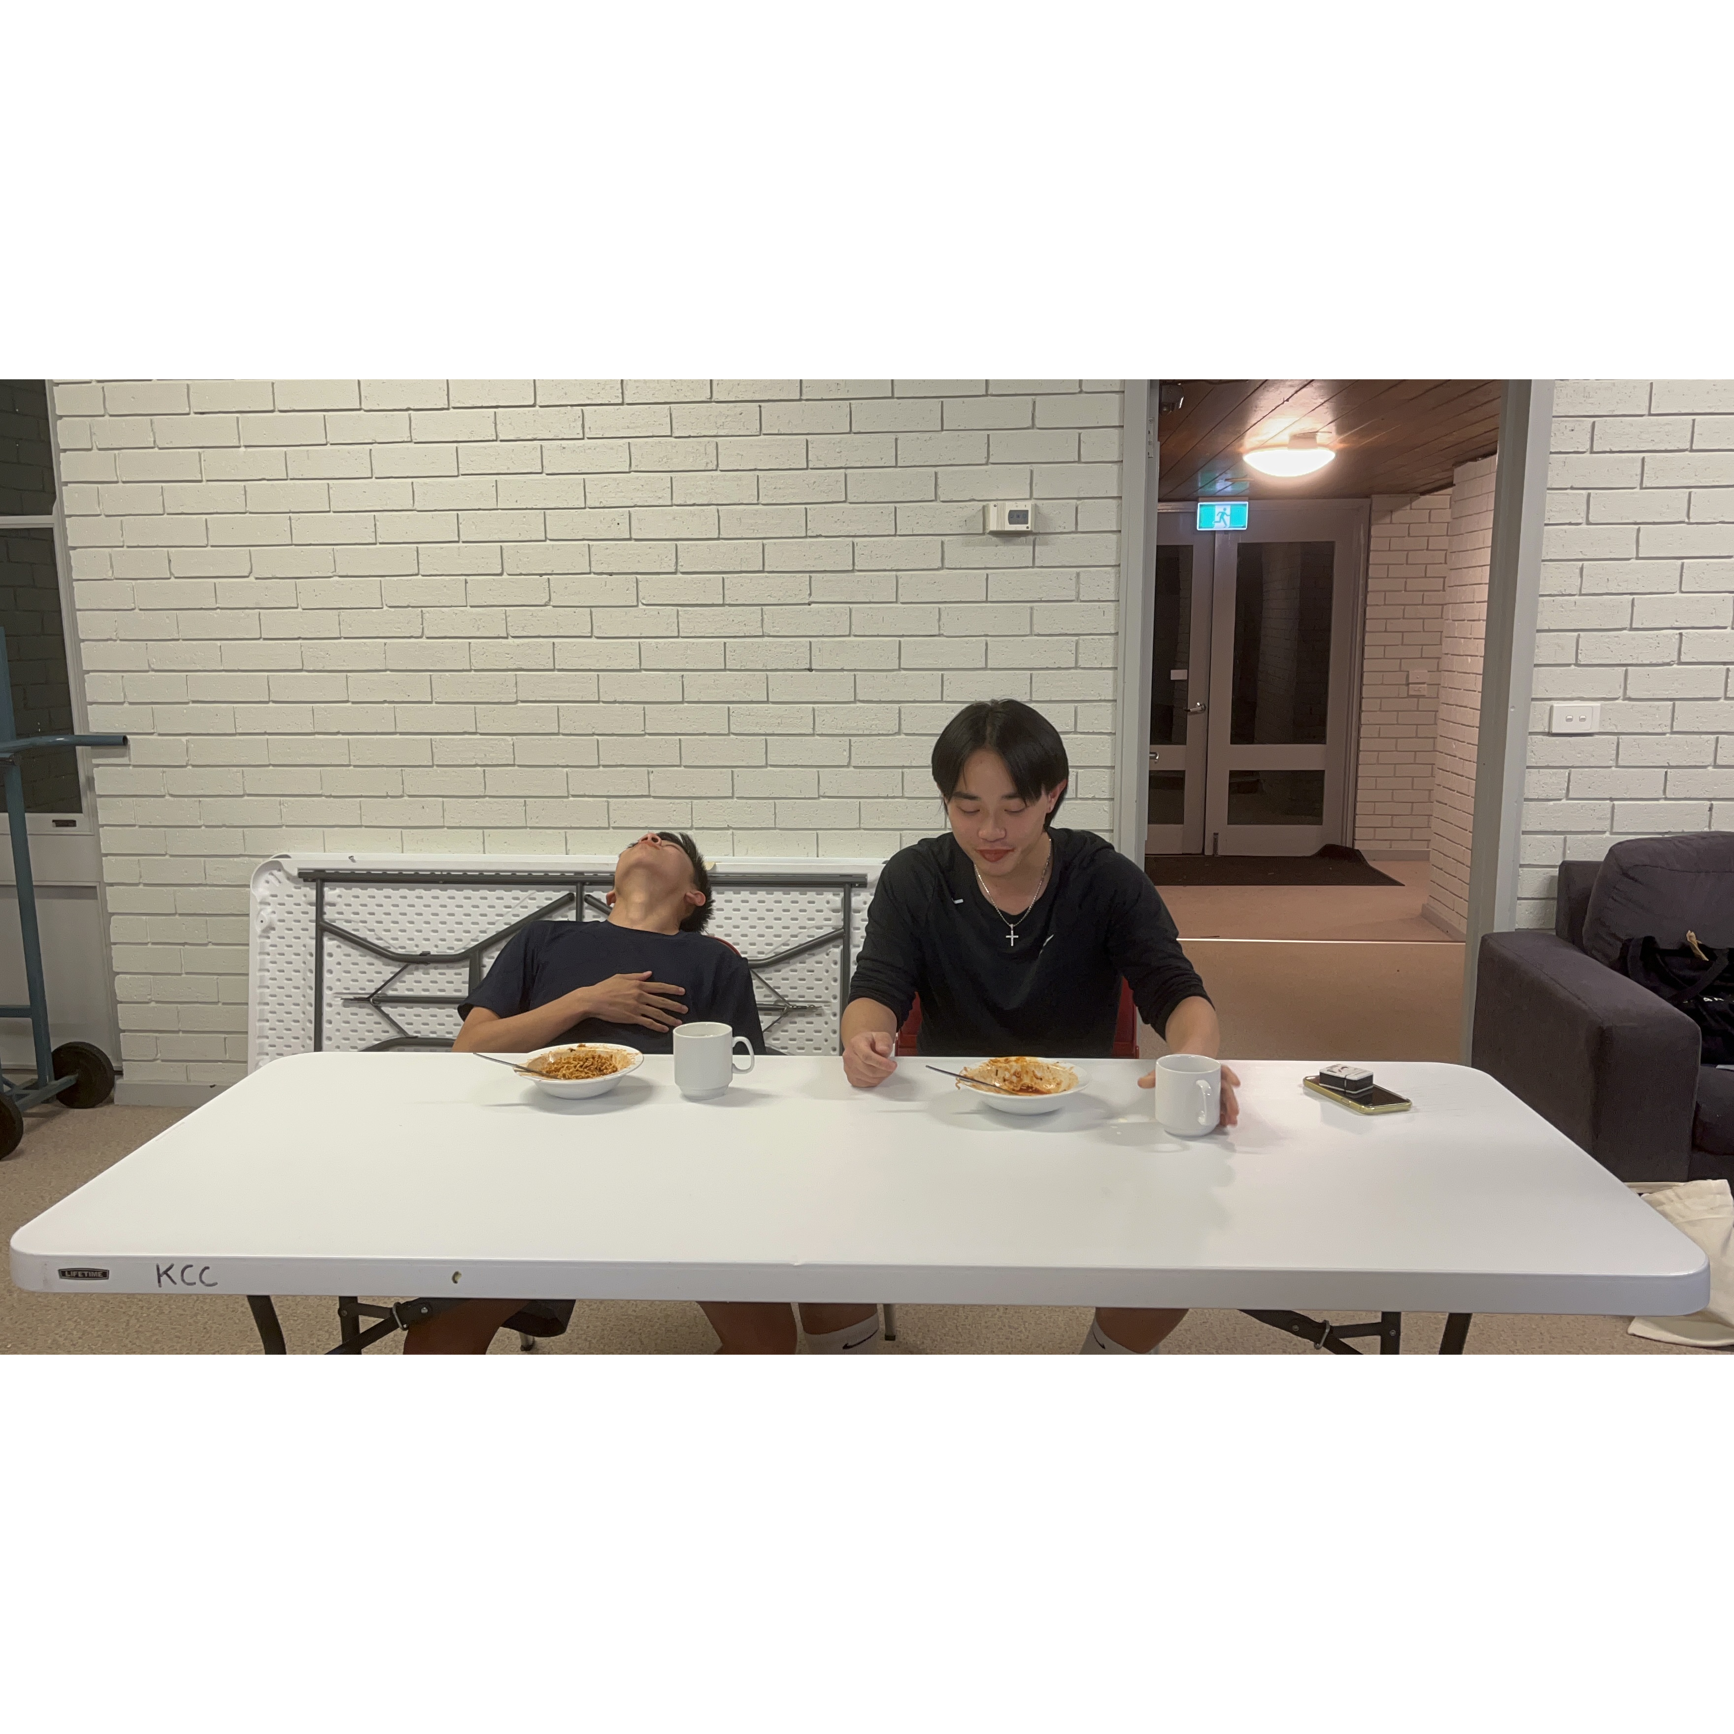
Mingle time!

